Slide 1
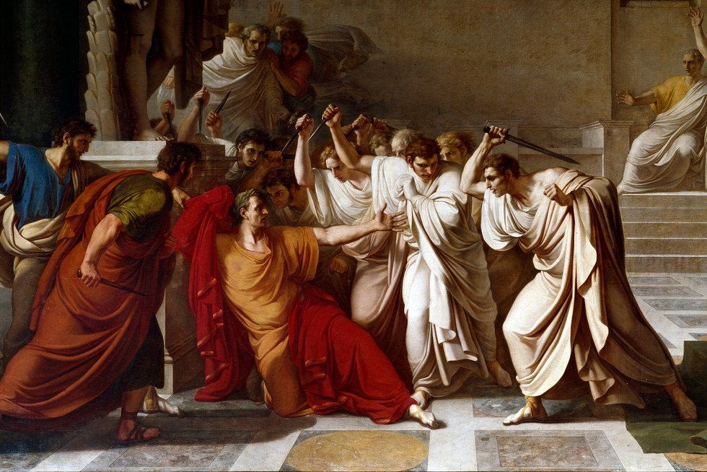
Rome – Religious Structures
GOAL/S: Identify and describe Roman Religious Structures
Week 2, Lesson 3

Slide 2
The values, customs, and beliefs of Ancient Romans were often a mix of those they had inherited from their ancestors and those adopted from societies they conquered. Together, these beliefs, values, and practices had an impact on how the people of Ancient Rome lived.

Slide 3
Watch the following:
https://www.youtube.com/watch?v=W-11rLwSUHM&ab_channel=TheSPQRHistorian

Slide 4
Beliefs and values in Ancient Rome
polytheistic – belief in more than one God
adapted from Greek gods and goddesses – admired Greek culture
also deities of other conquered people (e.g. Persia, Egypt)
worshipped in temples and home
festivals, rituals, and ceremonies – most important part of religious practice

Slide 5
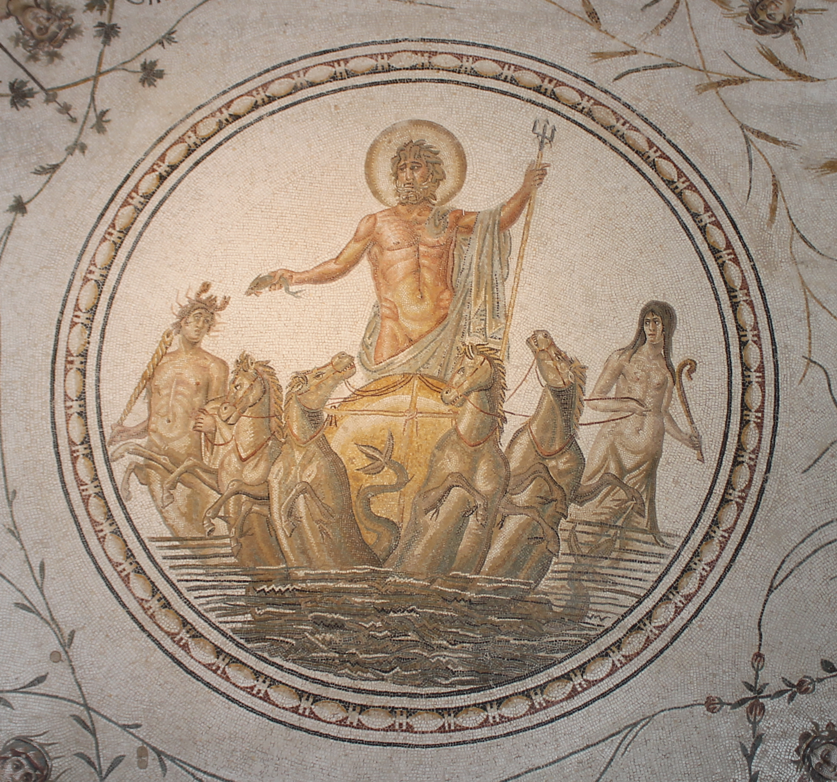
Source 1
Triumph of Neptune
Author: Unknown
Date: 2nd century
Medium: Marble
4.9m x 4.8m
Discovered: Chebba, Tunisia (North Africa)

Slide 6
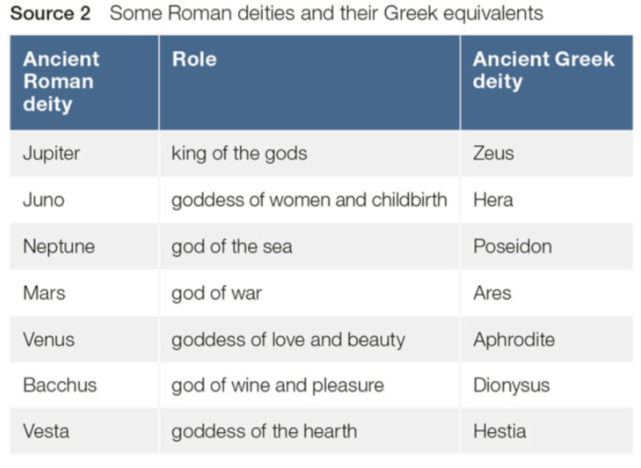
Source 2
Some Roman deities and their Greek equivalents.

Slide 7
Ancient Rome and Christianity
many gods = originally feared Christianity
motivated many Roman leaders to try and stamp out Christianity
300 years – Romans who converted to Christianity were tortured or killed
crucified, burnt life, fed to lions (colosseum)
HOWEVER Christianity continued to spread
380CE – Emperor Theodosius made it Rome’s official religion
The Vatican (the seat of the Roman Catholic Church) and the Pope are located in Rome to this day

Slide 8
The Ancient Romans lived by an unwritten (but very important) code of values that influenced their behaviours and attitudes in all aspects of their daily life. Every Roman was expected to practice these values at all levels of society – private, political, and military.

Slide 9
ACTIVITY – Ancient Roman Values
Create a mindmap, table, or graphic organiser of the 6 Roman Values

Slide 10
Ancient Roman Values

Slide 11
TEACHER ONLY
Value | Meaning
Industria | Willingness to work hard; dilligence
Dignitas | A sense of personal pride and self-worth
Virtus | Courage, honour, toughness, desire to excel
Fides | Honesty, trustworthiness, dependability
Gravitas | Self-control, dignity, seriousness, responsibility
Pietas | Respect, dutifulness, good living, devotion to worship and others

Slide 12
ACTIVITY - Research
Conduct ONE (1) full page of research into the spread of Christianity in Ancient Rome.
Research the following:
Who was Saint Paul, and what was his role in spreading the message of Christianity?
Which emperor eventually made Christianity legal, and in what year?
Which emperor later declared Christianity the state religion, and all other deities illegal?
What impact/s – short and long term – did Christianity have on Rome?

